Slide 1
How do I create basic statistical models?
IMAT5168 Analytics Programming

Slide 2
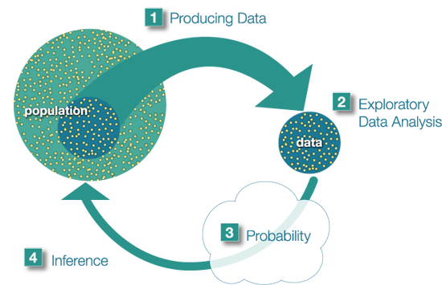
Stages in statistical modelling
https://oli.cmu.edu/repository/webcontent/b83cca4680020ca601894e758ec447b9/_u1_intro_stats_online/webcontent/inference.png

Slide 3

Statistical Modelling Overview
Population
What are the characteristics of the population?
Sampling to produce data
How was the sample created?
How were measurements performed?
Exploratory data analysis
Identify the number of groups in the dependant and independent variable
Look at data in tables & graphs overall and by groups
Distributions, Scatter plots, Box-whisker plot etc
Statistical modelling
Create an appropriate statistical model
Choose the model based on the dependant variable type
And the independant variable type
Check the assumptions of the model
e.g. Source data normally distributed?
e.g. Residuals normally distributed?/Homogeneity of variance?
If assumptions violated
Revise the model
Interpret the results
Did the sampling result in representative groups?
Were measurements performed in the same way for each group?

Slide 4
t-test analysis tasks
Tasks
SAS program
Read in and clean the data
Choose statistic
Choose continuous variable
Choose categorical variable
Fit the model
Test the assumptions
Interpret the results
DATA input
proc TTEST
VAR variable
CLASS variable
H0=? Sides=?
Q-Q plots for normality if sample < 30
P-value
Means
Difference of means
Confidence interval for difference of means

Slide 5
Two sample t-test
Prentice (1986) compared ‘lean’ and ‘obese’ women’s energy expenditure (MJ/day)
proc ttest * add h0=value if 1 sample;
data = prentice1986;
class bmi; /* group by bmi assessment */
var energy; /* energy expenditure */
run;
Results:
P = 0.0008, using pooled estimate of variance
Difference = 2.23 MJ/day (95% CI 1.05-3.14)
Means:
Lean women = 8.07 MJ/day
Obese women = 10.30 MJ/day

Slide 6
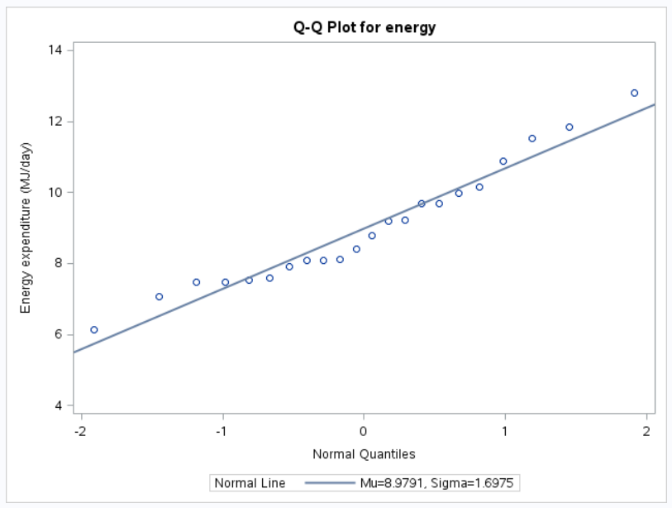


t-test assumptions

Slide 7
One way ANOVA analysis tasks
Tasks
SAS program
Read in and clean the data
Choose statistic
Choose continuous variable
Choose categorical variable
Fit the model
Check Homogeneity of Variance
Store the residuals
Test the assumptions
Determine which group is different.
DATA input
proc ANOVA or GLM
(see MODEL)
CLASS variable
MODEL outcome=risk factor
HOVTEST=BARTLETT
GLM: OUTPUT OUT=…
proc UNIVARIATE QQPLOT
MODEL o=r / test

Slide 8
One way ANOVA data
Amess (1978)
Population:
patients undergoing cardiac surgery
Intervention:
patients were divided into 3 groups and underwent different patterns of ventilation during and after the operation.
Outcome:
red cell folate levels after 24h ventilation
Research question:
Is there a difference between the 3 groups?

Slide 9
One way ANOVA procedures
proc glm
data = amess1978;
class ventilation;
model folate=ventilation;
means ventilation /
lsd /* pairwise comparisons */
hovtest=bartlett; /* homogeneity of variance*/
output out=amess1978p p=predicted r=residual;
run;
proc univariate
data=amess1978p
plot normal;
var residual;
qqplot /
normal(mu=est sigma=est); /* normally distributed? */
run;

Slide 10
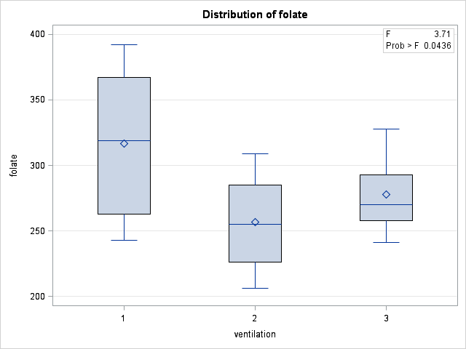
Exploratory analysis
Question:
Is ventilation group 2 significantly different from the others?
Null hypothesis:
All ventilation groups are the same.

Slide 11
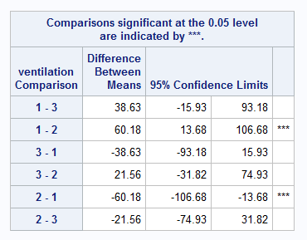

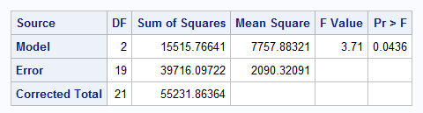
One way ANOVA results

Slide 12
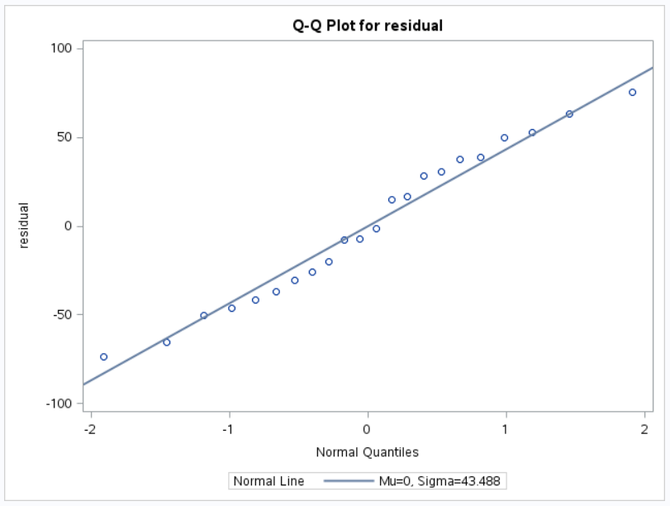

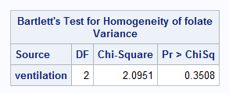
One way ANOVA: review of assumptions

Slide 13
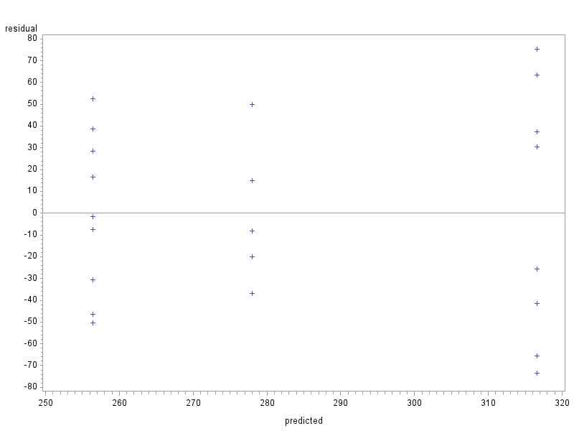
One way ANOVA assumptions
Residual plot
Spread of residuals is broadly similar around y=0

Slide 14
Regression analysis tasks
Tasks
SAS program
Read in and clean the data
Choose statistic
Choose continuous variable
Choose categorical variable
Fit the model
Store the residuals
Test the assumptions*
Look at the predictions*
* produced automatically
DATA input
proc REG or GLM
(see MODEL)
CLASS variable
MODEL outcome=risk factor
REG: OUTPUT OUT=…
proc UNIVARIATE QQPLOT
proc SGPLOT REG…

Slide 15
Regression data
Manatee data set
From Bailer
“Florida Powerboats and manatee deaths 1977-1990” in Moore, D, McCabe G (2003) Introduction to the practice of statistics 4th Ed. New York; WH Freeman & Co.
Yearly:
Number of manatee deaths
Number of registered powerboats (thousands)

Slide 16
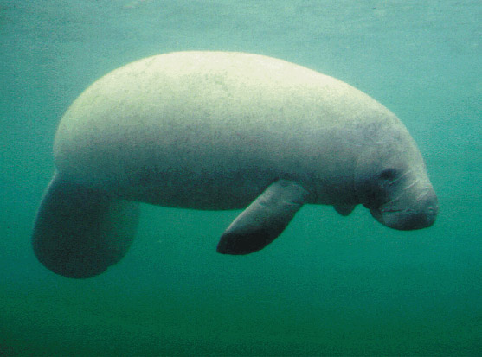
Manatees
By U.S. Department of the Interior, U.S. Geological Survey - Photo from U.S. Geological Fact Sheet 010-99; FS-010-99, Public Domain, https://commons.wikimedia.org/w/index.php?curid=10299

Slide 17
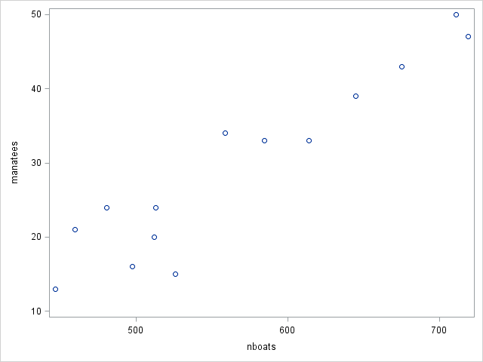
Exploratory analysis
“Florida Powerboats and manatee deaths 1977-1990” in Moore, D, McCabe G (2003) Introduction to the practice of statistics 4th Ed. New York; WH Freeman & Co

Slide 18
Regression procedures
proc reg data=manatee_deaths;
model manatees = nboats /
p r * prediction residual;
cli * prediction interval for new observation;
clm * confidence interval for mean response;
;
output out=man_pred p=yhat r=resid;
run;
proc univariate
data = man_pred
plot normal;
var resid;
qqplot /normal(mu=est sigma=est); * residual vs normal QQ plot;
histogram /normal;
run;
proc sgplot data=man_pred; * Y vs. X plot with;
reg x=nboats y=manatees/clm cli; * pred. reg. line and;
run; * and conf/pred limits;

Slide 19
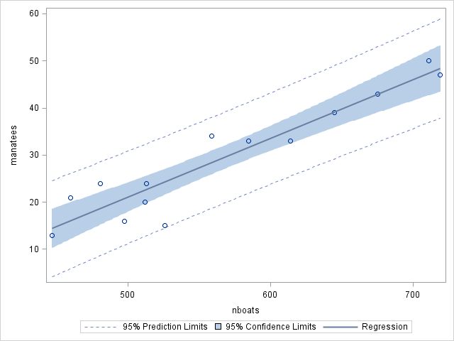
Regression results
“Florida Powerboats and manatee deaths 1977-1990” in Moore, D, McCabe G (2003) Introduction to the practice of statistics 4th Ed. New York; WH Freeman & Co
The plot suggests a relationship between manatee deaths and the number of power boats.

Slide 20
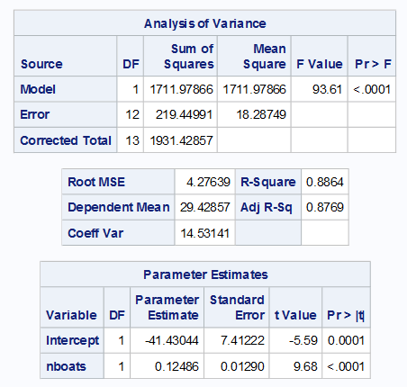
Regression results
“Florida Powerboats and manatee deaths 1977-1990” in Moore, D, McCabe G (2003) Introduction to the practice of statistics 4th Ed. New York; WH Freeman & Co
The relationship between number of power boats and manatee deaths is confirmed.

Slide 21
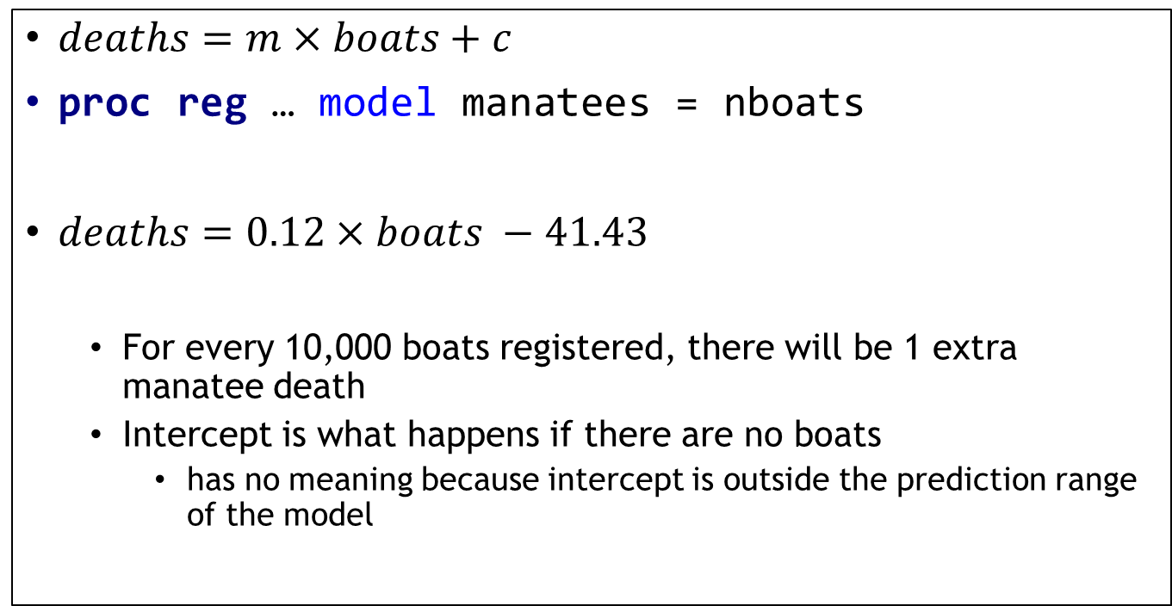
Regression: interpret results
$deaths=m×boats+c$
proc reg … model manatees = nboats
$deaths=0.12×boats −41.43$
For every 10,000 boats registered, there will be 1 extra manatee death
Intercept is what happens if there are no boats
has no meaning because intercept is outside the prediction range of the model

Slide 22
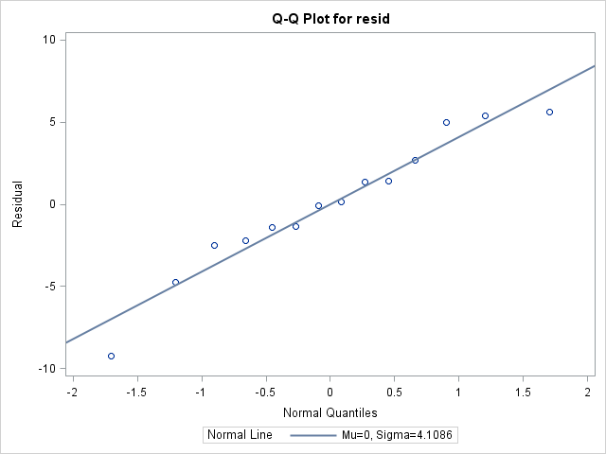
Regression assumptions
“Florida Powerboats and manatee deaths 1977-1990” in Moore, D, McCabe G (2003) Introduction to the practice of statistics 4th Ed. New York; WH Freeman & Co
The residuals are normally distributed so the parametric statistic is appropriate.

Slide 23
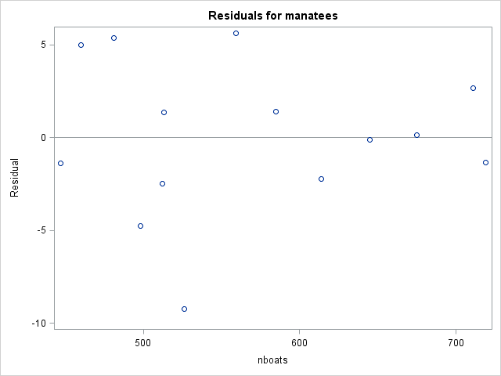
Regression assumptions
“Florida Powerboats and manatee deaths 1977-1990” in Moore, D, McCabe G (2003) Introduction to the practice of statistics 4th Ed. New York; WH Freeman & Co
Spread of residuals is broadly similar around y=0

Slide 24
Assumptions violated?
Parametric models
rely on assumptions about (transformed) data or residuals fitting the normal distribution
are more robust if the data has no outliers (values > 3s from the mean)
Non-parametric models
require larger samples to prevent false positive and false negative errors
i.e. have ‘less power’
but make fewer assumptions
i.e. are ‘more robust’
The choice depends on the data
Numeric data related to ranks, where ‘+1’ has no meaning should suggest the use of a non-parametric test
Or on evaluation of parametric test assumptions & the data cannot be transformed

Slide 25

Parametric Statistical Models
Dependent variable (DV):
Continuous
Independent variable (IV):
Categorical or continuous variable dividing DV into…
Models
One group t-test, $μ$
Two independent groups t-test
Two dependent groups t-test on difference, $μ_{diff}$=0
3 or more groups one way ANOVA
Ordered groups ANOVA with linear trend
Infinite groups (continuous IV) regression

Slide 26
Non-parametric tests
What happens when the assumptions of parametric tests are violated?
Attempt to transform the data so that the assumptions are met
If this cannot be done, consider using non-parametric tests…
SAS commands with non-parametric statistics are sometimes not obvious:
proc univariate
proc npar1way
proc freq

Slide 27

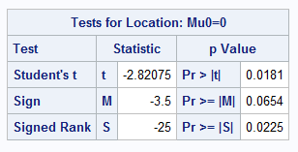
Single sample test (Wilcoxon)
The code
The results…
data energy;
input intake;
/* Calculate difference */
diff = intake - 7725;
label
intake = 'Daily energy intake (kJ)';
datalines;
5260
/* More intake values */
;
run;
proc univariate
data = energy;
var intake diff; qqplot intake
/ normal (mu=est sigma=est);
histogram intake / normal;
run;

Slide 28
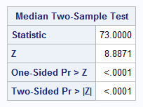
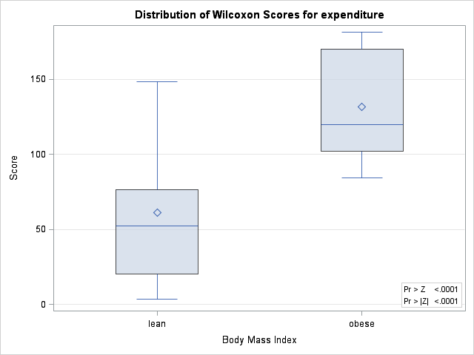
Two sample test: Wilcoxon
The results
The code
data energy2;
infile datalines;
input bmi expenditure;
. . .
datalines;
1 6.13
. . .
2 8.79
. . .
run;
proc npar1way
data = energy2
wilcoxon
median
plots=(wilcoxonboxplot medianplot);
class bmi;
var expenditure;
freq expenditure;
run;

Slide 29
Two way ANOVA
What happens if there is more than one independent variable?
Example:
A mail order catalogue firm has collected data to investigate the effect of:
the size of a magazine advert and
the advert design
on the number of catalogue requests received.
Three designs (A, B & C) and two different sizes (Small, Large) of adverts were chosen.

Slide 30
Mail Order Data Set
Data:
Data layout
Small Size
Advert Design
A | B | C
9 | 22 | 10
12 | 14 | 18
13 | 17 | 12
Large Size
Advert Design
A | B | C
13 | 25 | 18
9 | 29 | 14
13 | 24 | 14
Dependent variable:
number of requests (1000s)
Independent variables:
Size of advertisement
Small
Large
Design of advertisement
Design A
Design B
Design C
Notes:
Move second table (large size) underneath small size

Slide 31
Organisation of the raw data
Data step…
Dependent variables classify Independent variables
data advert;
infile datalines;
input
size $
design $
requests
;
/* datalines go here */
run;
datalines;
Small A 9
Small A 13
Small A 12
Small B 22
Small B 14
Small B 17
Small C 10
Small C 18
Small C 12
Large A 13
Large A 9
Large A 13
Large B 25
Large B 29
Large B 24
Large C 18
Large C 14
Large C 14
;
Notes:
Move data in items 3-n out of slide…

Slide 32
Two Way ANOVA Theory
Total variation =
variation due to advert size
+ variation due to advert design
+ variation due to combinations of advert & design
+ error
Combinations of size & design = interaction
Test selects between models:
No effect of size, design or interaction
Size has an effect, design & interaction do not
Design has an effect, size & interaction do not
Size & design have an effect without interaction
Size & design have an effect with interaction

Slide 33
What is interaction?
If there is interaction:
The relationship between size and requests is dependent on the value of design
Or the relationship between design and requests is dependent on the value of size
The interaction plot lines cross each other.
If there is no interaction:
The relationship between size and requests is independent of the value of design
Or the relationship between design and requests independent of the value of size
The interaction plot lines are parallel.
If there is no interaction
the interaction term may be removed from the model

Slide 34
Assumptions of 2-way ANOVA
For each combination of factors
The samples are independent random samples
Advert data: true
There are an equal number of measurements
Advert data: true
More later…

Slide 35
Two way ANOVA
proc glm
data= advert;
class design size;
model /* includes interaction */
requests=
design
size
design*size; /* interaction */
lsmeans design size design*size;
output /* save residuals for later */
out=predicted
p=predicted r=residual;
run;

Slide 36
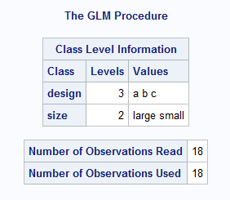

The results
First check:
Have observations been lost?
Are there equal numbers in each cell?
$2×3=6$ cells
Number of observations used = 18
$18÷6=3$ observations per cell – matches our source data

Slide 37
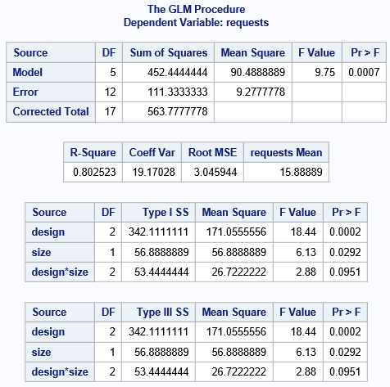
The GLM procedure
A mail order catalogue firm has collected data to investigate the effect of:
the size of a magazine advert and
the advert design
on the number of catalogue requests received.
This shows that the model is significant and explains ~80% of the variation.
The design and size terms are significant but the design*size (interaction) term is not.

Slide 38
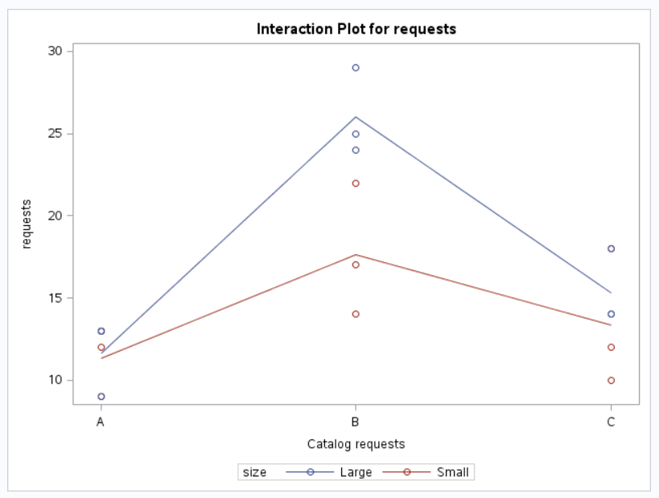
Interaction Plot
Interaction between:
Catalog requests
Design size
Confirms no interaction

Slide 39
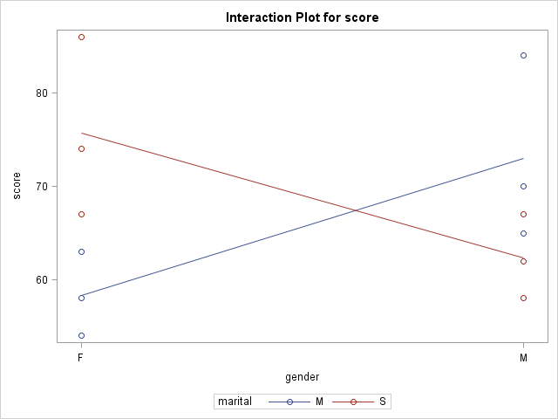
Interaction plot
Illustrative plot using different data to show the pattern when there is interaction

Slide 40
Interpretation of Interaction
When there is interaction:
Only the combination of factors (independent variables) affects the outcome (dependent variable).
Nothing can be said about each factor alone

Slide 41
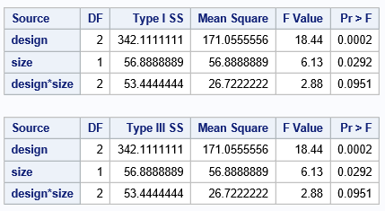
Interpretation of interaction
Two way ANOVA interpretation
Output table
Interaction term:
design * size: p > 0.05
Interpretation:
there was no interaction
Action:
remove interaction from model

Slide 42
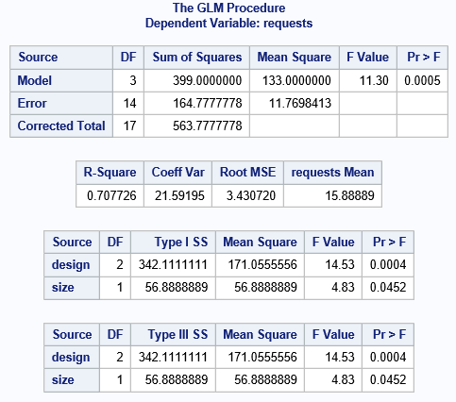
Model without interaction term
The same code as previously but:
design*size was removed from the model term
design*size was remived from the lsmeans term

Slide 43
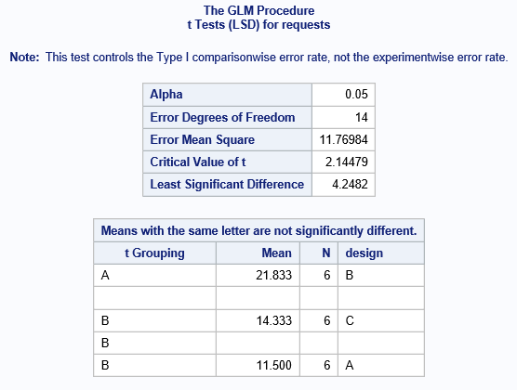
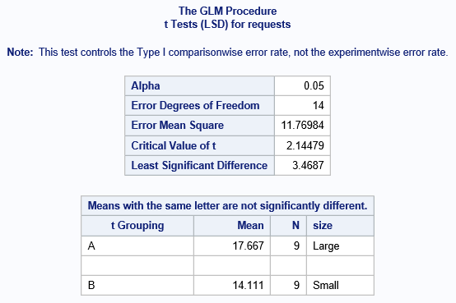
Model without interaction
The effect of design
The effect of size

Slide 44
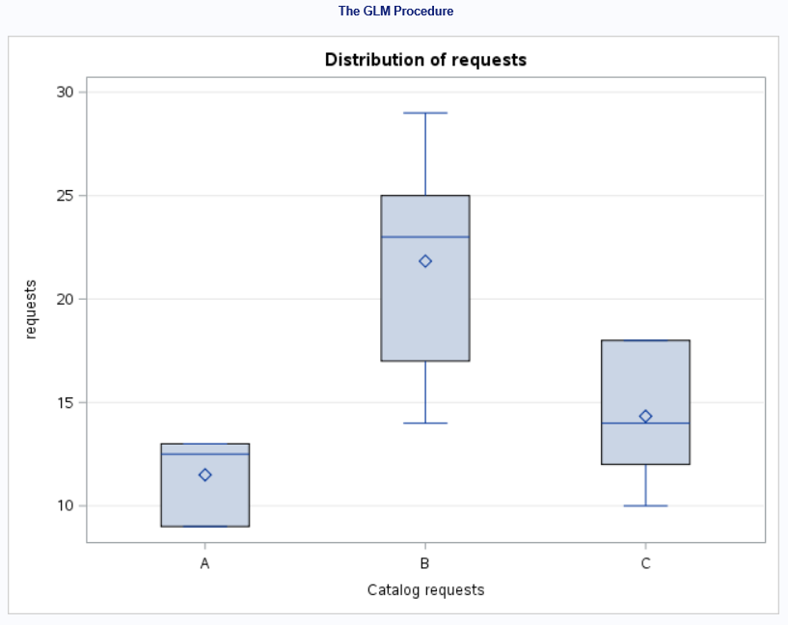
Model without interaction
Design B is significantly different from designs A & C

Slide 45
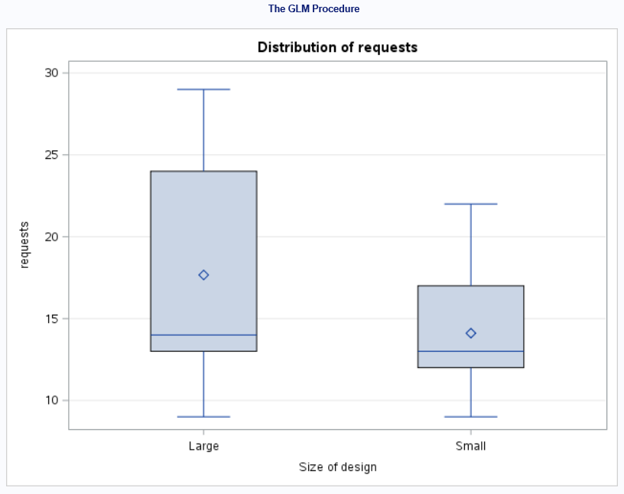
Model without interaction
Large design is significantly different from small design

Slide 46
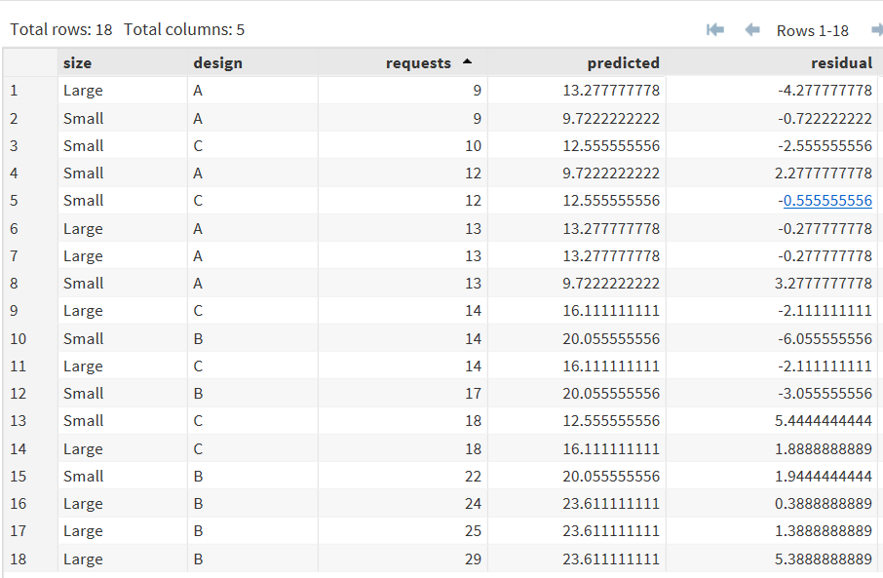
Review assumptions…
Saved residuals
The code…
Test if the residuals are normally distributed:
proc univariate
data=nointeract
plot normal;
var residual;
histogram /normal;
qqplot
/ normal(mu=est sigma=est);
run;

Slide 47
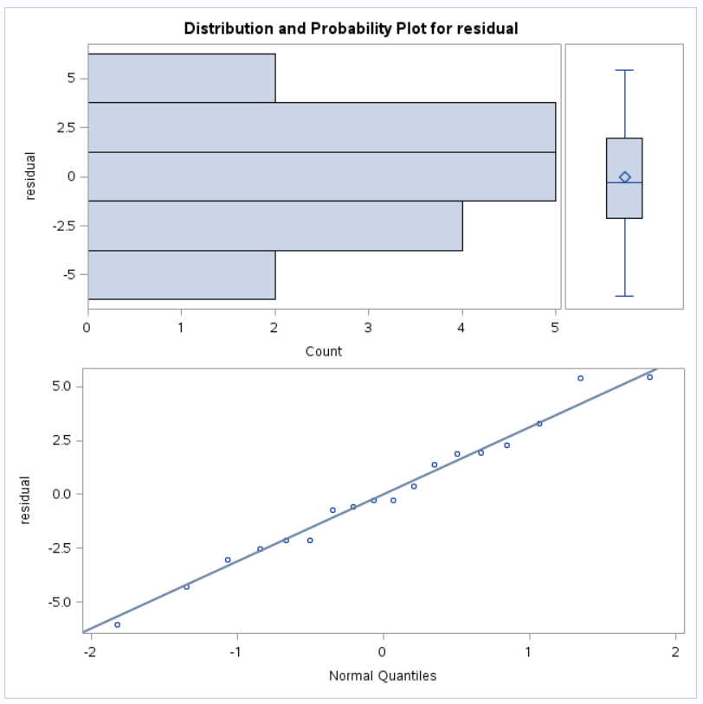
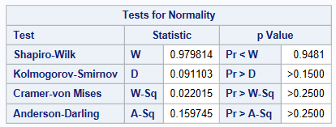
Are the residuals normally distributed?
Tests for normality
Plots

Slide 48
Two way ANOVA
Conclusion
For:
Dependent variable = requests
Independent variables = size and design
The assumptions of the test were met.
There was no interaction between size and design.
There was an effect due to size and due to design.
Design B attracted significantly more requests.
Large size attracted significantly more requests.

Slide 49
Summary
Statistical analysis techniques:
continuous variables
increasing numbers of groups
Strategy:
state the research question
explore the data
carry out the modelling procedure
examine the assumptions
interpret the results
Many subtleties
t-test – paired data, homogenous variance
ANOVA – trend, homogenous variance
Regression – non-normal data
Efficient
Aim for one test that uses as much data as possible

